Slide 1
Predicting Security Vulnerabilities
Group 8
Baran Barut
Michael Harris
Curtis Helsel
Kyle Reid
Thomas Serrano
Advisor: Dr. Paul Gazzillo
Contributor: Dr. Elaine Weyuker

Slide 2
Project Overview

Slide 3
Project Idea Overview
Background:
Security vulnerabilities and code faults are inevitable and exist everywhere
Idea:
Automate detection of security faults by correlating metrics from the development cycle with previously detected faults
Questions:
Can this be accomplished with modern tools?
Can it deliver good accuracy?

Slide 4
Common Terminology
Code Fault:
Undefined behavior in software that can produce incorrect or unexpected results
Security Vulnerability:
Software behavior that can be exploited by a threat actor usually introduced through code faults
Common Vulnerability Enumeration (CVE):
A list of identification numbers that details data points for publicly known cyber-security vulnerabilities
Notes:
Describe the difference between a fault and a vulnerability
A vulnerability is a fault that can be exploited

Slide 5
Code Fault Example
strcpy, a method that does not check the destination to ensure it is large enough for the operation to complete successfully, is executed, causing potential undefined behavior when the dest string is printed to screen.
int main() {
char src[] = "buffer overflow";
char dest[2];
strcpy(dest, src);
printf("%s", dest);
return 0;
}
Notes:
Describe the difference between a fault and a vulnerability

Slide 6
Security Vulnerability Example
Here, a string is provided by the user, which is meant to return a user record in the database.
The vulnerability can be caused by not sanitising input, since the equation “1=1” will always evaluate as true, which, if passed into the above code, can be used to return every user and their password from the database. This is clearly an exploit of the above code fault.
txtUserId = getRequestString("UserId");
txtSQL = "SELECT * FROM Users WHERE UserId = " + txtUserId;
SELECT UserId, Name, Password FROM Users WHERE UserId = 105 or 1=1;
Notes:
Tie it up at the end, “these are the kind of things our model will predict since it is what they will be trained to find”

Slide 7
Project Motivation
Projects are large & complex
Software testing takes time, money, and people
Information technology is increasingly ubiquitous
Allow developers to release a more stable, tested, reliable product
Less vulnerabilities, improvement to the development cycle
Notes:
If successful, software eng more secure by reduce vulns, improve dev cycle

Slide 8
Project Objectives
Predict security vulnerabilities within code using code metrics from public GitHub repos and the project’s file structure
Provide users with informative security analytics regarding their code
Improve upon existing work in the field by utilizing:
Machine Learning statistical modeling
Data acquisition using publicly available APIs and file metadata
Determine feasibility of using metrics from development cycle to predict vulnerabilities and faults
Notes:
2 - including location
3 - automated
4 - supplement code review process

Slide 9
Technical Content

Slide 10
Existing Work
Predicting the Location and Number of Faults in Large Software Systems:
Thomas J. Ostrand, Elaine J. Weyuker, and Robert M. Bell
Negative binomial regression model that predicts the number of faults in a file
Predictions based on code faults and modification history of previous releases
Applied to 2 large industrial systems at AT&T:
The top 20% of predicted problematic files contained between 71% and 92% of the faults that were actually detected, with the overall average being 83%
Showed it is possible to predict faults with intensive efforts to map faults with metadata
Notes:
Write the flow better, Curtis

Slide 11
Original Project Specifications
Application:
Ease of use
Show where issues lie in repo
Display informative analytics to end user
Data Scraping and Parsing:
Must pull repo metrics from GitHub
Parse commit log, local file structure for faults
Machine Learning:
Make accurate predictions based on features
Evaluate features to determine effectiveness of data fields
Backend:
Host data, modeling tools and database
Notes:
Good summary of the design choices (github, commit log) and requirements we had

Slide 12
Project Refinement (Iterations)
Searching git logs for bug-specific keywords like ‘bug’, ‘security fault’, ‘CVE’
Data pulled in was irrelevant, faults were rare and did not reflect actual bugs
Commit messages were not related to security faults
False accuracy due to skewed model data which was unable to make accurate predictions
Considered CVE Database as potential candidate for solid data, dual path intake pipeline
Due to non-representative repo fields, accuracy was no better than a coin flip across different architectures
Decision made to move forward without repo fields as it increases model accuracy
Matches problematic files with ‘good’ files to prevent data skew
File-related features from repos within CVE database
Additional data features developed in the hopes of further improving accuracy
Notes:
curtis

Slide 13
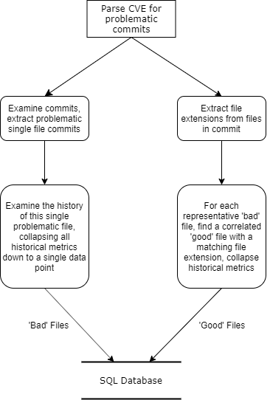
Dual-Path Data Intake Diagram
CVE database is parsed for problematic commits
Only commits with a single problematic file are examined
Problematic files are matched with good files
Keeps data representative
Model knows what a ‘bad’ and a ‘good’ file look like in equal measures
Prevents model from estimating accuracy of not having a fault
Non-fault files much more common, would skew dataset
Notes:
Pls dont read off this slide verbatim, walk thru the diagram and just kinda talk about what we did

Slide 14
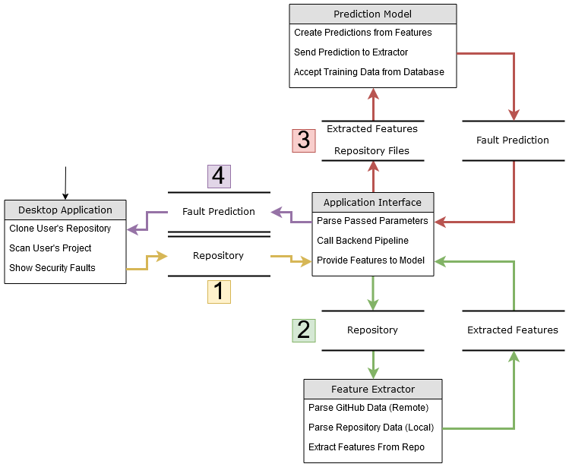
Project Flow Diagram
Notes:
Write the flow better

Slide 15
Data Acquisition

Slide 16
Data Acquisition Technologies
Data Source:
GitHub
CVE Database
Programming Language:
Python (v3.7)
Libraries Used:
PyGitHub
GitPython
OS
MySQL.Connector
Integrated Development Environment (IDE):
PyCharm
Notes:
Other than Collecting data the technologies used was vital to grab quality data.
We used Github and a CVE Database containing repositories with known security issues as our data source
We also worked in Pycharm and used the python programming language with its array of useful libraries to gather the data.

Slide 17
Github Data
Easily accessible and holds the commit log history
Using Python Libraries: PyGitHub, GitPython
Examples
Contributors, Stargazers, Forks, Commits, Code Frequencies
Notes:
We split our data points into two groups the first being github data
This was easily accessible data and had the added benefit of containing the commit log history more data about the repo
We used PyGithub and Gitpython for grabbing this data.
examples..

Slide 18
File Data
To gather more precise data on projects
Using Python’s built-in OS library for accessing files and folders
Examples:
Line Count, Number of Indents, Number of Subdirectories
Notes:
The second type was the file data.
This data focused more on the individual files and would offer more data and a more accurate prediction
We used pythons os library to gather this data
examples...

Slide 19
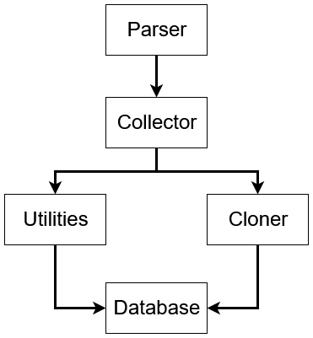
Data Acquisition Process
Parser:
Gets CVE data
Turns data into a list of valid repos
Collector:
Pulls important features from repos
All information is sent to the database
Notes:
Here is a simple flow chart showing the process of our data collection script…
Parser gets the cve data and turns it into a list of valid repositories
The collector pulls important features
Sends to database

Slide 20
Extra Features
Gather more data points to produce a more accurate result
def num_file(path):
files = []
for (_, _, filenames) in walk(path):
for filename in [f for f in filenames]:
files.extend(filenames)
break
return max(0, len(files))
Notes:
Needed as many data points for ML as possible
Brainstormed & wrote our own on things that cld predict vulns

Slide 21

Data Parsing
Turn raw data into useful data
Vital for ML
{‘foo.c’: {‘insertions’: 4, ‘deletions’: 3, ‘lines’: 17}}
{‘bar.java’: {‘insertions’: 3, ‘deletions’: 3, ‘lines’: 7}}
{‘main.py’: {‘insertions’: 1, ‘deletions’: 8, ‘lines’: 9}}
{‘bar.java’: {‘insertions’: 0, ‘deletions’: 8, ‘lines’: 23}}
{‘main.py’: {‘insertions’: 13, ‘deletions’: 3, ‘lines’: 9}}
{‘main.py’: {‘insertions’: 1, ‘deletions’: 1, ‘lines’: 2}}
{‘example.cpp’: {‘insertions’: 1, ‘deletions’: 2, ‘lines’: 3}}
{‘foo.c’: {‘insertions’: 6, ‘deletions’: 6, ‘lines’: 6}}
{‘main.py’: {‘insertions’: 3, ‘deletions’: 2, ‘lines’: 7}}
[‘foo.c’, 5.0, 4.5, 11.5]
[‘bar.java’, 1.5, 5.5, 15.0]
[‘main.py’, 4.5, 3.5, 6.75]
[‘example.cpp’, 1.0, 2.0, 3.0]
Notes:
w/o data, ml doesn’t work. w/o good data, ml doesn’t work well
Parse out files with vulnerabilities to train with, extracts features for ML from the noise
Extract info related to those vulnerabilities for ML
Only store the processed data on the server

Slide 22
Application Interface
Connects all the pieces of the project
Facilitates communication between the desktop application, data layer, and machine learning model
Separate flow control supports local repositories, and public and private remote repositories
Notes:
Tom
Takes arguments from app, collects & processes data, passes to ML, and then passes output back to app
Complicated - a lot of moving parts

Slide 23
Data Acquisition Successes & Difficulties
Successes:
Technologies
Collecting data
Difficulties:
Getting good data
Parsing the data
Interface hard to debug
Notes:
Python powerful & easy to use, many git libraries
Github has tons of projects to work w
Collecting & parsing had some problems - had to create our own functions
Once everything was integrated, had to test whole project - good & bad
Note that Elaine’s project worked well because they had great internal data sets - something that we don’t have
Tools should alleviate this
They had a dedicated team & could actually talk to developers

Slide 24
Backend

Slide 25
Backend Overview
Flexibility initially important due to changing project scope
Database connects Data Collection and Modeling roles
Seamless experience, no end-user interaction with the model
Website to download the application and learn about the project
Notes:
website

Slide 26
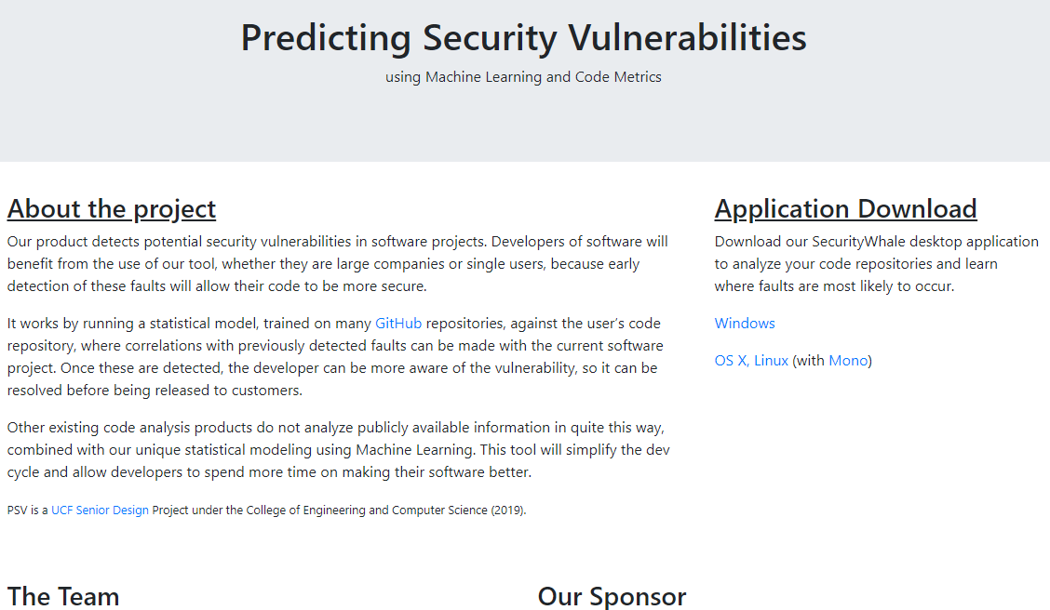
Website

Slide 27
Backend Technologies
Ubuntu VM hosted by Digital Ocean:
MySQL Database to connect Data, Modeling roles
Local database connections through mysql.connector
Bootstrap website running on Apache, SSL cert through Let’s Encrypt
Anaconda - Python Sandboxing

Slide 28
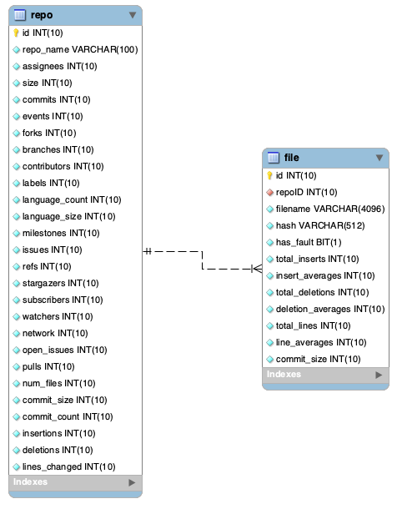
Database Entity
Relationship Diagram
First iteration of the database included fields common to repos
repo -> file is one-to-many
Low accuracy improved once repo fields were dropped from the training set

Slide 29
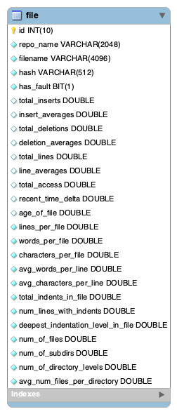
Database Entity
Relationship Diagram
Repo table eliminated, not beneficial to model accuracy
Single table to hold file relevant fields
Double floating point representation used to standardize model input
Fields represent metadata and development cycle metrics

Slide 30
Backend Successes and Difficulties
Successes:
Easy to deploy Digital Ocean droplet
MySQL very straightforward, easy to define entity relationships
Database served as a reliable data store for modeling and data roles
Difficulties:
Data tool runs on a local copy of the repo for speed
Best option, running remotely would take much longer
Database field changes require re-running the data collection utility, which requires extensive parsing

Slide 31
Machine Learning

Slide 32
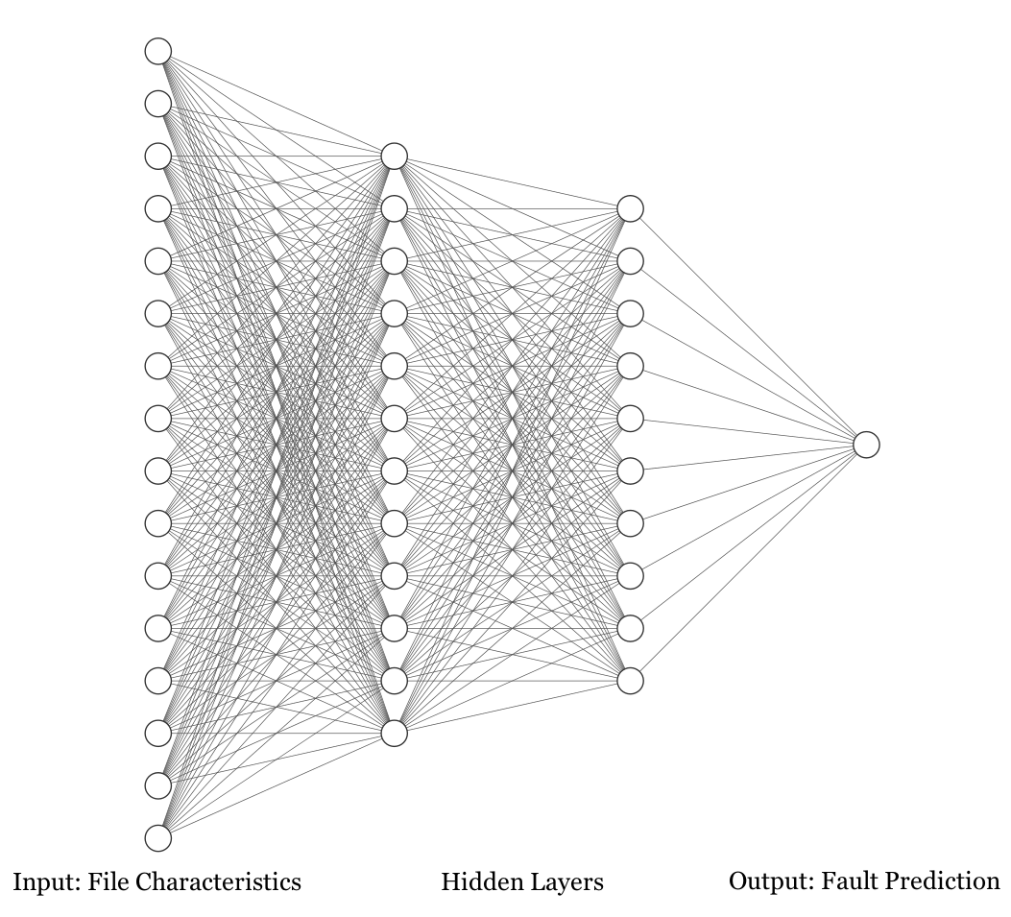
Network Flow
Feed-forward network with backpropagation
Features of individual files are input to network:
Stack of repository and file information
Output is the fault prediction for file:
Sigmoid activation with binary cross-entropy loss
Holdout Validation

Slide 33
Machine Learning Technologies
Programming Languages:
Python
Libraries:
Numpy
Keras
Tensorflow
Scikit Learn

Slide 34
Prediction Results & Accuracy
90% Accuracy - False accuracy due to skewed training set
50% Accuracy - Nominal, no better than a coin flip. Using both repo and file fields
60% Accuracy - Increased accuracy when only using file fields
60% Accuracy - Using only file fields and additional file features (21 total features)

Slide 35
Machine Learning Successes & Difficulties
Successes:
Created a model for remote repositories with a 60% accuracy
Groundwork created to support future researching
Prior machine learning experience
Difficulties:
Updates to Tensorflow 2.0
Uncharted territory (research-oriented project)
Troubleshooting backend errors caused by library incompatibilities

Slide 36
Application
Notes:
Baran?

Slide 37
Desktop Application Overview
WinForms desktop application written in C# using .NET Framework v4.6.1
Performs the entire scanning process from start to finish
No having to deal with running scripts or machine learning knowledge necessary
Presents to the user a general overview of where security faults may lie
Includes a variety of accessibility options such as tab indexing and tooltips
Allow as many users as possible to use the application
Utilizes Travis CI for automatic building and unit testing on Ubuntu 18.04
Compiles and runs on any operating system that supports Mono Runtime & .NET Core

Slide 38
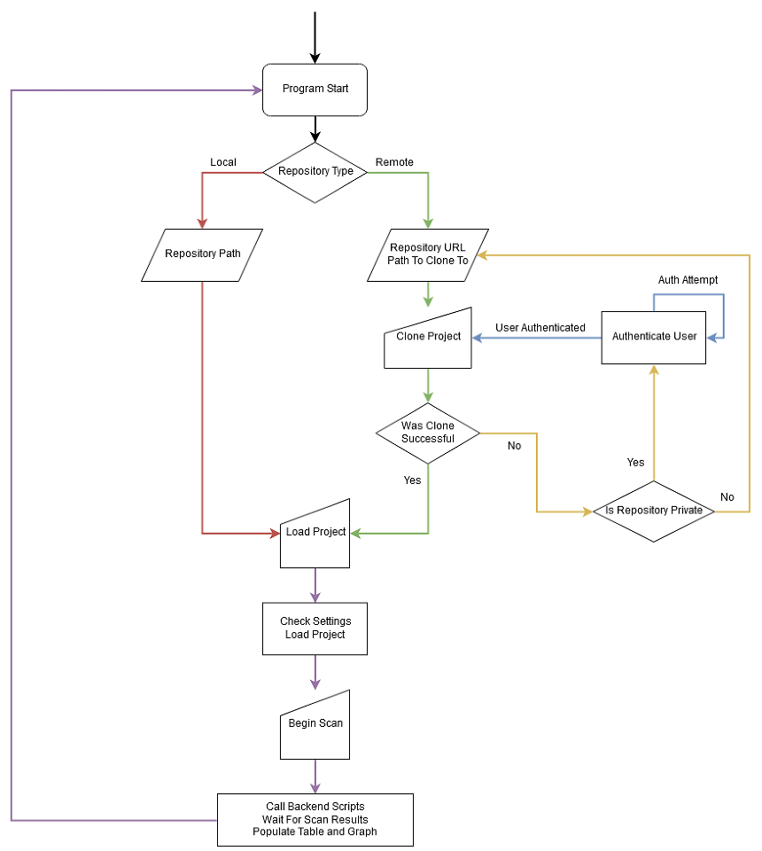
Application
Flow Diagram
There exist many avenues for the program to take depending on repository type
The application allows for the cloning of private repositories by authenticating with GitHub

Slide 39
Demo: Remote Cloning & Loading

Slide 40
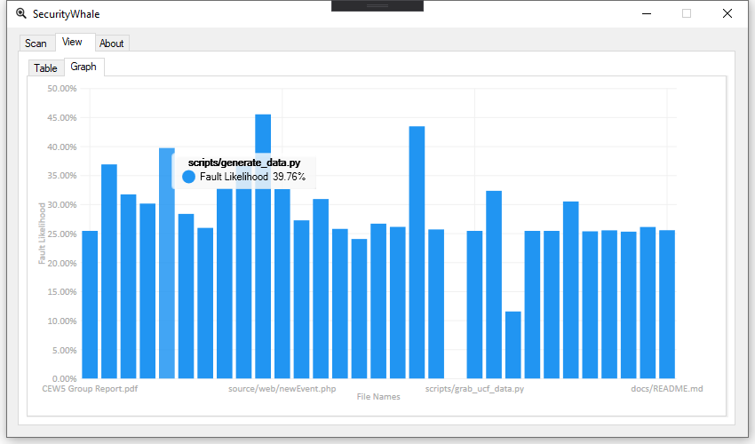
Application Example Output (Graph)

Slide 41
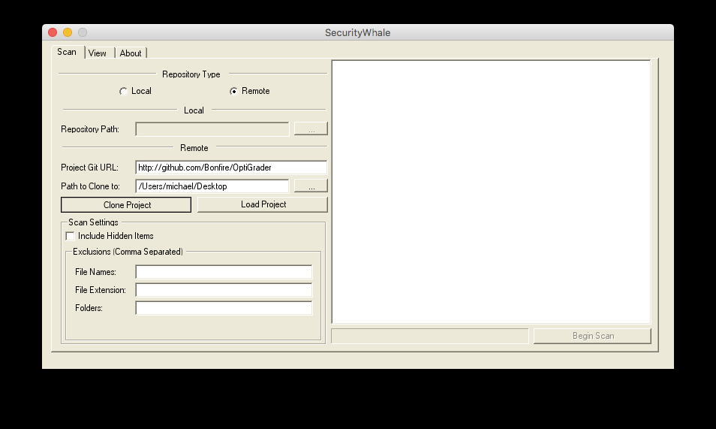
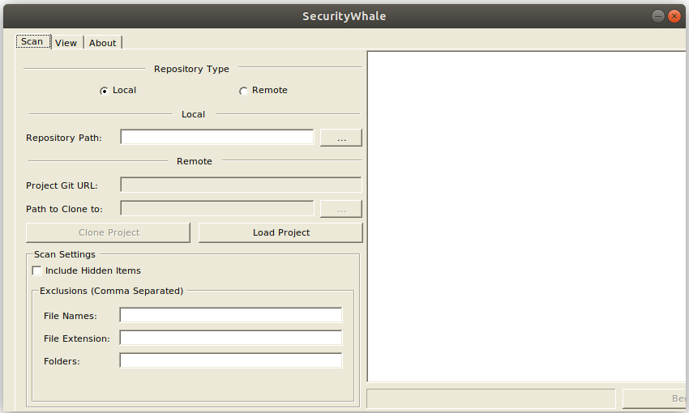
Demo: Multi-Platform Capabilities
macOS (El Capitan) Ubuntu 18.04
This is done using .NET Core and Mono Runtime

Slide 42
Design Choice: Desktop vs. Web Application
Privacy:
Could not reasonably guarantee project privacy with an online web application
No traffic, credentials, or code routed through us or our servers
Allows for completely offline/local scanning
Houses the user’s data on their own computer, users control their data
Efficiency:
Not reliant on our processing speed
Better suited for a desktop environment

Slide 43
Project Testing Plan
Utilizes Microsoft Unit Testing Framework for Managed Code
Uses the “Arrange, Act, Assert” (AAA) testing paradigm
Six Unit Tests:
Ensures that each component on its own works as expected
Inputs example data, acts, and asserts expected outputs
Two Integration Tests:
Ensures that each “group” of unit tests work as expected, in order
Steps through each unit testing group to find issues between integrated units

Slide 44
Application Successes & Difficulties
Successes:
Prior desktop application development experience
Plethora of libraries to assist in application implementation
Extremely verbose C# documentation and developmental ecosystem
Difficulties:
Application architecture and design
Creating the test plan
Researching accessibility features

Slide 45
Administrative Content

Slide 46
Budget and Finances
5 x 1 month of 24/7 server hosting $50
2 x Printing Design Document with UCF Discount $34.44
Total project cost: $84.44

Slide 47
Milestones
Weeks | Milestone
Sep 15 - Sep 21 | Data Collection Utility (DCU, 1st Iteration)
Sep 22 - Sep 28 | CVE Database Parsing Completed
Sep 22 - Sep 28 | Application Cloning & Loading Finished
Sep 15 - Oct 5 | Model Trained, Can Predict Faults w/ 60% Accuracy
Oct 5 - Oct 27 | Data Pipeline (2nd Iteration)
Oct 27 - Nov 12 | Fine Tune DCUv2 & Parsing, Improve Model Accuracy
Nov 7 - Nov 20 | Develop Additional File Features, Application Interface
Nov 20 - Dec 2 | Testing Plan Finished, 3rd Iteration Testing

Slide 48
Overall Successes and Difficulties
Successes:
Excellent team dynamic
Exciting project, fun to work on
Achieved an acceptable accuracy for fault predictions
Overall research question answered
Difficulties:
Research-based nature of the project (uncharted territory)
Data acquisition pipeline took much longer than we expected
Scope restricted us from performing detailed analyses on files

Slide 49
Final Thoughts

Slide 50
Moving Forward (Additional Exploration)
Explore alternative neural network types:
Recurrent neural network
Generative adversarial network
Intra-file fault prediction (granular model):
Where in the file the fault would occur
Integrated Development Environment integration:
In the form of a plugin, scanning while doing software development

Slide 51
Conclusions
Obtaining good data was even more difficult than we thought
Various machine-learning architectures did not affect model accuracy within the repo-file model
Scalability:
Parsing a commit log for historical file data is not scalable to very large projects
Issues when testing integration between Application and Backend
Properly managing the control flow for complex applications is very difficult
Using code metrics to make predictions about the presence of security faults is possible
Notes:
Architecture = parameters

Slide 52
Demo

